Slide 1




MECHANICAL
WBS 2.5.1: Electrical Box Thermal Design
Polina Verkhovodova
04/16/21
Meeting with Dr. Keith Novak (JPL)
High level discussion of thermal design process
New information: consider thermal response at junctions, consider thermal response in operating and non operating modes, think about power draw and power dissipation, dust is a problem for thermal radiators, thermally isolated part vs connected
Components needed: MLI, heat pipe radiators, white paints
*Just* got in contact with a few experts at JPL (thanks to Keith) who can tell us more about where to purchase materials and for design validation
Keith said heat pipes may be expensive :/

Slide 2
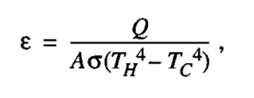
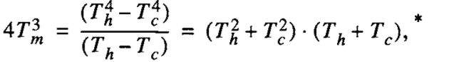

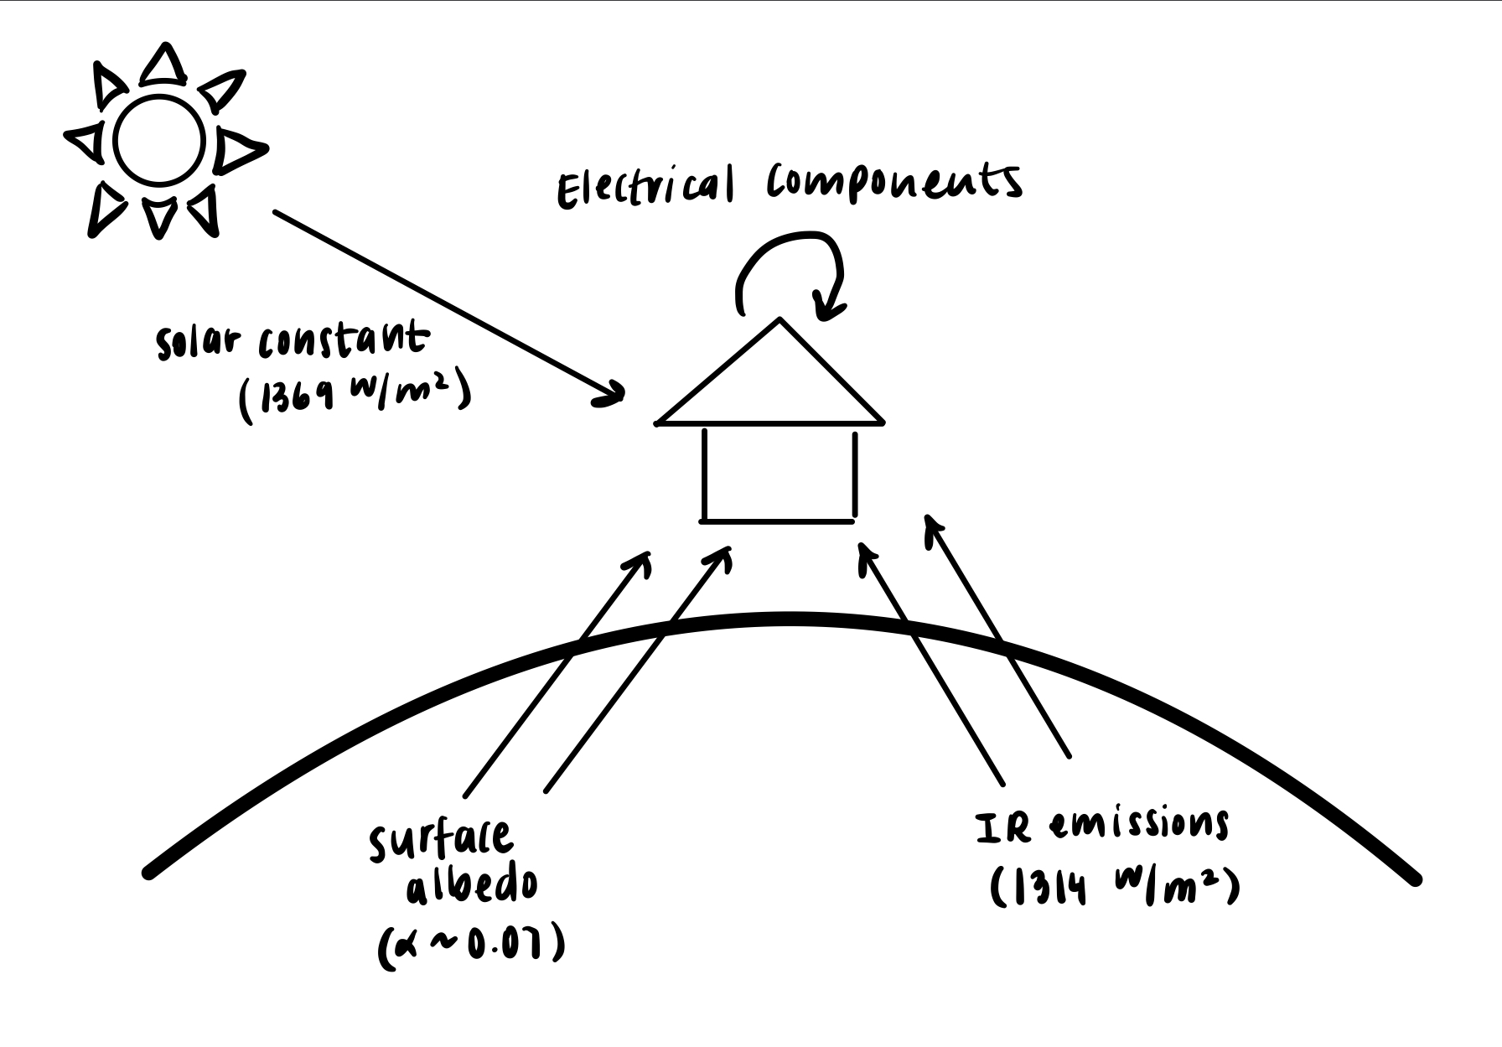
MECHANICAL
WBS 2.5.1: Electrical Box Thermal Design
Polina Verkhovodova
04/16/21
Research:
Relevant equations for MLI:
Relevant equations for radiators:
Started spreadsheet to keep track of these numbers.

Slide 3
MECHANICAL
WBS 2.5.1: Electrical Box Thermal Design
Polina Verkhovodova
04/16/21
For TRL 5+, we should build and test the full thermal control system
There are many models (Excel and other software, $) that we can use to model our thermal design
Would like to discuss with Validation team
Thermal radiator is a significant power draw (TBD on the numbers)
Discussion for later: Do we really need to get a radiator system for the purposes of our project? If we don’t, HOMES will not be at TRL 5+?
Haven’t actually confirmed whether we need radiators, but from discussion with Keith and own research I think we will need it (mainly bc of extreme temperature range)
For TRL 4, we can just state that we propose to use xyz thermal control solutions but we can use a less involved system for the earth-bound prototypes
Action: start to physically design the box, CONFIRM electrical components, get in touch with people at JPL regarding MLI and heat pipes

